Slide 1
Web basics
--Sri Harsha, CyberEye.

Slide 2
Introduction:
The world wide web consists two sorts of participants, Clients and Servers.
They both interact with one another
Clients: Things like laptops, desktops, mobile phones, and all of which are interested in content that’s provided by servers.
Servers: These are things like shopping websites (Eg: Amazon), information websites (Eg: Wikipedia), blogs and so on…
A client runs a browser like chrome, internet explorer and at server on runs web server
Some examples of web server : Apache, HTTPD, Engine X, IIS by Microsoft and many more

Slide 3








The Web, Basically
Client
Server
Browser
Web server
Database
Web server
(Private) Data
Database
(Much) user data is!
part of the browser
DB is a separate entity,!
logically (and often physically)

Slide 4







Basic structure of Web Traffic
Client Server
Browser
Web server
Database
Browser
HTTP
Web Server
(Private) Data
Database
HyperText Transfer Protocol (HTTP)
An “application-layer” protocol when using the OSI network stack protocol and it runs on top of TCP (Transmission Control Protocol) which can exchange collection of data.

Slide 5
Basic structure of Web Traffic
Client Server
Browser
HTTP Request
Web server
User clicks
Requests contain:
The URL of the resource the client wishes to obtain
Headers describing what the browser can do
Request types can be GET or POST
GET: all data is in the URL itself (no server side effects)
POST: includes the data as separate fields (can have side effects)

Slide 6
Let’s have a look at some examples

Slide 7
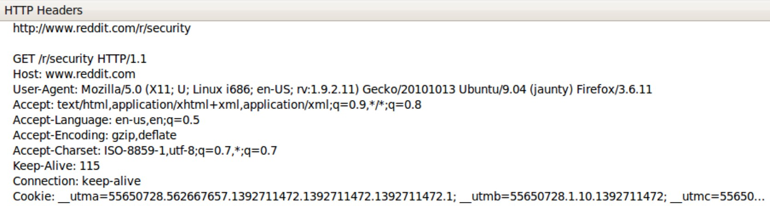

HTTP GET requests
http://www.reddit.com/r/security
User-Agent is typically a browser
^{but it can be wget, JDK, etc.}

Slide 8
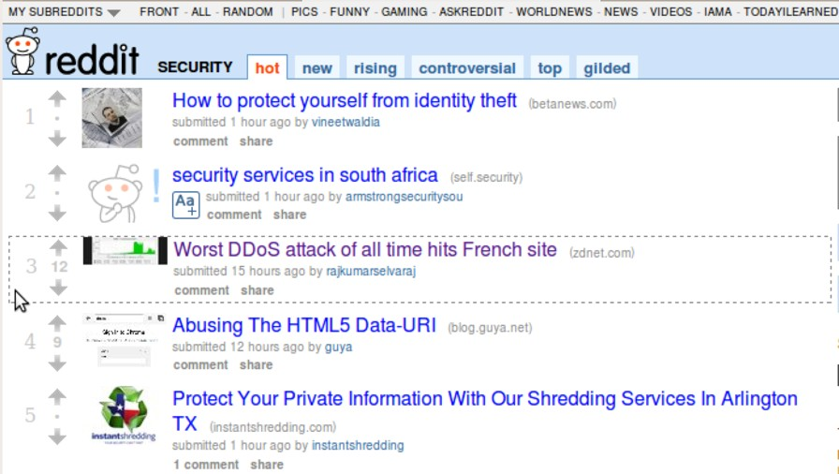
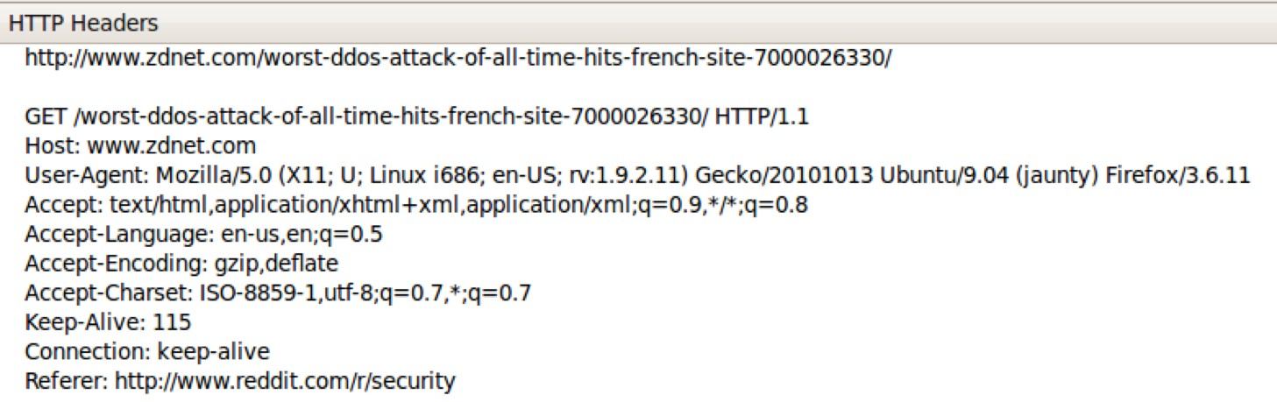
Referrer URL: the site from which
this request was issued.

Slide 9
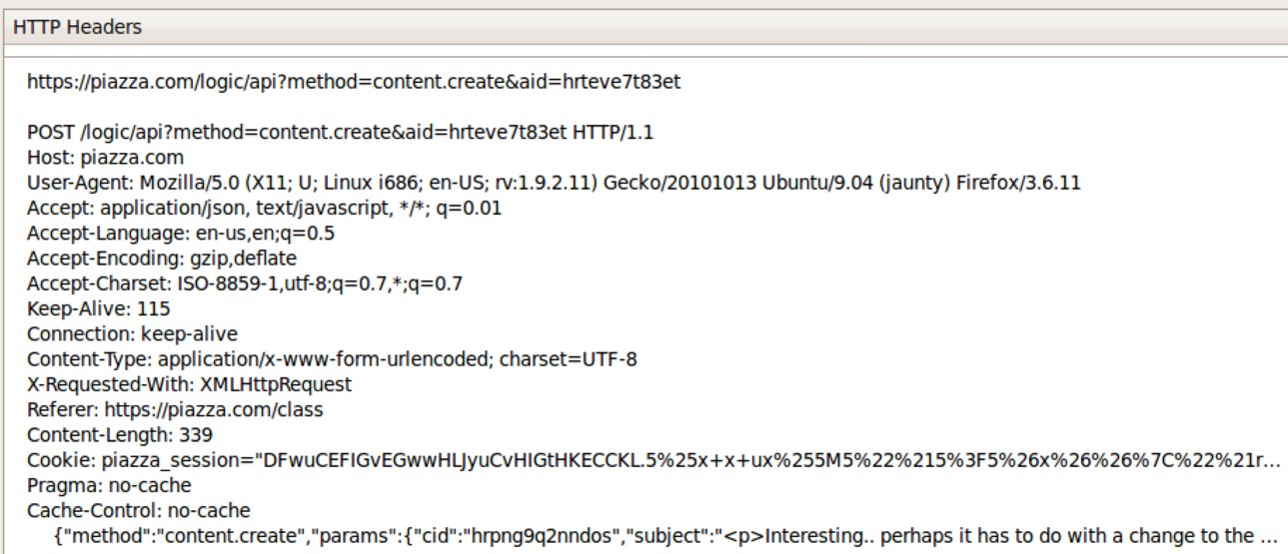

HTTP POST requests
Posting on Piazza
Implicitly includes data as a part of the URL
Explicitly includes data as a part of the request’s content

Slide 10
Basic structure of web traffic:
After user clicks, HTTP Response will be generated.
Response contains:
Status code
Headers describing what the server provides
Data
Cookies
Represent state that the server would like the browser to store on its behalf.

